Slide 1
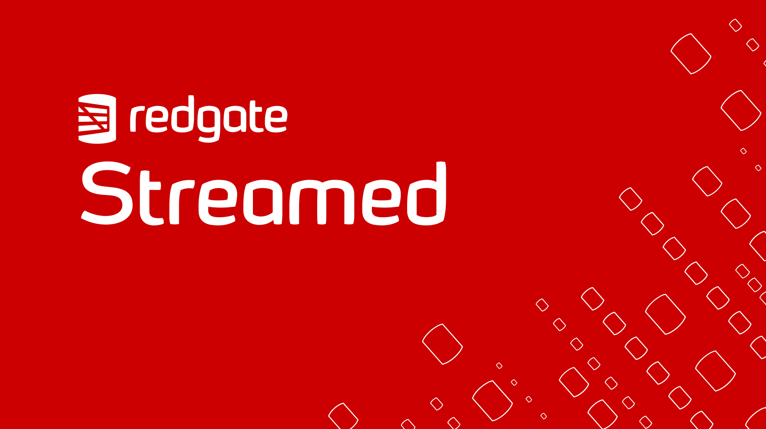

Slide 2

The Hybrid Model:
An optimized workflow for database source control

Slide 3





About me
Chris Unwin
Solution Architect
Redgate Software
@PlantBasedSQL
DBAle on the Redgate Hub

Slide 4

Goal
“To understand what models are available for database source control, how they are implemented within organizations and how to choose which best suits us.”

Slide 5

Source Control, before we get going…
There are lots of source control repositories out there…
Subversion (SVN)
Team Foundation Version Control (TFVC)
Mercurial
Vault
And others…

Slide 6


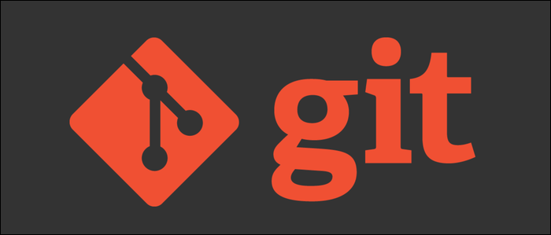
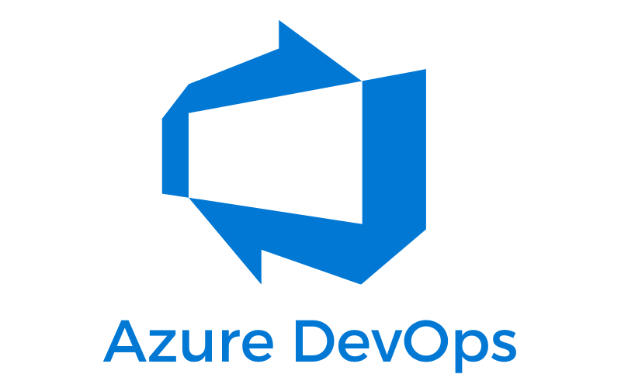

Source Control, before we get going…
But some are more popular than others!

Slide 7

Today’s Setup
What will I use today?
Git repositories in Azure DevOps
SQL Server Management Studio (SSMS)
SQL Server 2016
Redgate SQL Toolbelt

Slide 8

Model #1: State-First

Slide 9

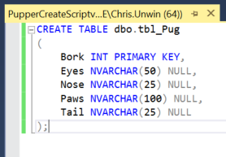

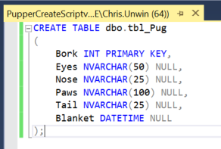
State-First Source Control
dbo.tbl_Pug
CREATE Script
Tables > dbo.tbl_Pug (Version 1)
dbo.tbl_Pug (Changed by Dev)
Newer CREATE Script
Tables > dbo.tbl_Pug (Version 2)

Slide 10

State-First
In Practice

Slide 11

State-First Source Control
What are the benefits?
A simple approach to get started with standardizing development practices.
Easy onboarding for teams in the Shared development model
Better for teams largely working on just programmable objects (stored procedures, views etc.)
Easy to implement tSQLt testing
Easier to roll-back to previous state

Slide 12

State-First Source Control
What are the drawbacks?
Not as easy to achieve small, incremental deployments
Not as easy to pick and choose changes to be deployed
Upgrade script determined at a later stage
Not as easy to refactor complex table changes

Slide 13
Model #2: Migrations-First

Slide 14
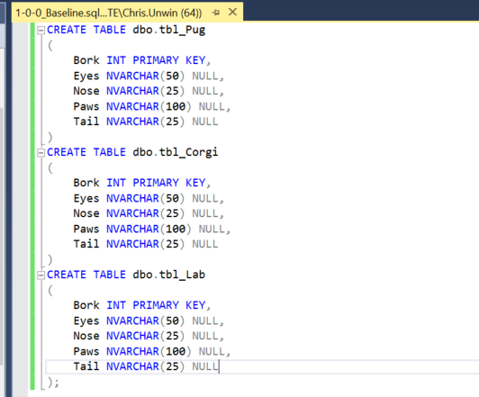


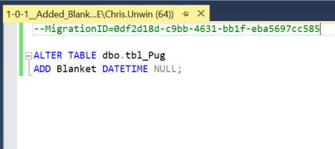
Migrations-First Source Control
All Database Objects tbl_Pug, tbl_Lab & tbl_Corgi
Baseline Script
Migrations > 1.0.0__Baseline.sql
dbo.tbl_Pug (Changed by Dev)
Migrations > 1.0.1__Added_Blanket.sql
Alter Script

Slide 15
Migrations-First
In Practice

Slide 16

Migrations-First Source Control
What are the benefits?
Focused on how to get to the desired end state through precisely controlled individual migration scripts
Enables small, frequent, incremental migrations and predictable deployments
Ideal for complex database changes and environments with high uptime requirements
Ability to use your own custom standards for table changes in deployments

Slide 17

Migrations-First Source Control
What are the drawbacks?
Not as intuitive if changes are reworked frequently by developers over short time periods
Not as easy to set up tSQLt testing framework
Not as easy to pick and choose changes to be deployed
Higher learning curve for teams
Harder to roll-back changes

Slide 18
Model #3: Hybrid-Model / ‘Optimized’ Model

Slide 19
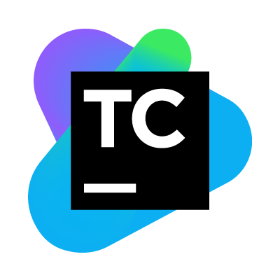

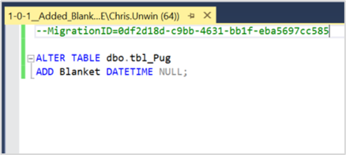


‘Optimized-Model’ Source Control
dbo.tbl_Pug change
Newer CREATE Script
Alter Script
Tables > dbo.tbl_Pug
(Version X)
Migrations >
1.0.1__Added_Blanket.sql
State
&
Migrations

Slide 20
‘Optimized-Model’
In Practice

Slide 21

‘Optimized-Model’ Source Control
What are the benefits?
Full granular history around object changes on a state level, but with customizability, flexibility and reliability of migration scripts
Separation of duties for Developers and Senior Team Leads / DBAs (who generates what / who has what speciality)
Easily extends existing state-first model where migrations are needed
Easier to pick and choose changes to go out
Lower learning curve

Slide 22

‘Optimized-Model’ Source Control
What are the drawbacks?
Additional step added to the process can make it feel like red-tape / added work
Could add some time to the overall development process for new changes
Duplicated schema model in Source Control repo

Slide 23

Conclusion
There are a number of options available for good, robust database source control.
Picking the best model for you in the hard part– pick the one that fits most with the agile processes your team wants to have in place.

Slide 24

Where can I learn more?
Documentation:
Change Automation Approaches
Hybrid Workflow: Development Source
The Redgate Hub:
https://www.red-gate.com/hub/
Contact us: info@red-gate.com
Previous Webinar:
Level up your deployments for SQL Source Control

Slide 25

Thank you for watching!

